Slide 1
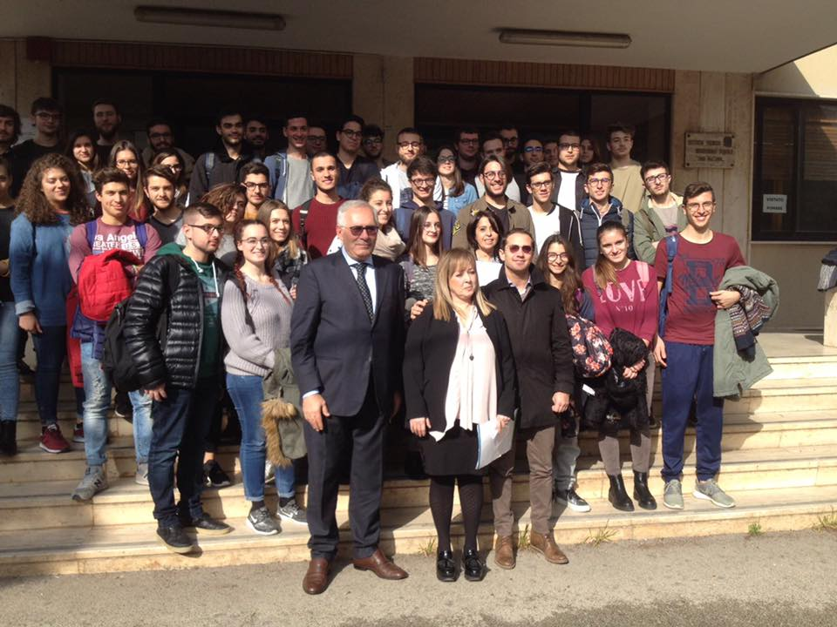
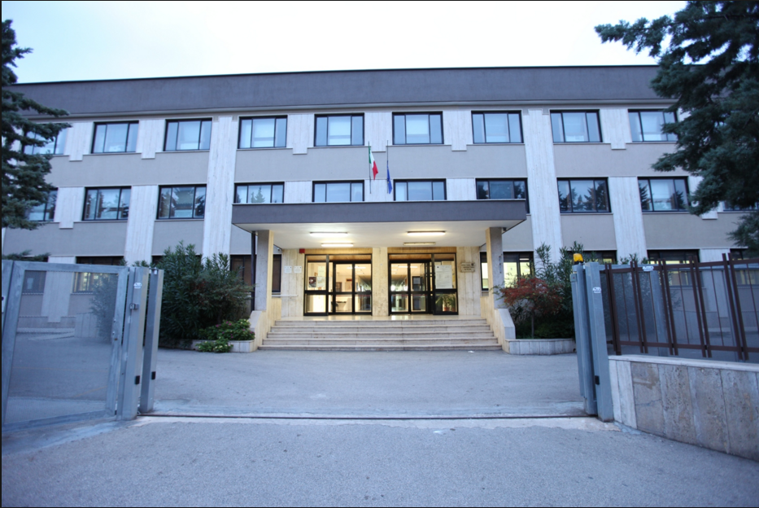
Technical Institute “Luigi dell’Erba”
Castellana Grotte (BA)
This is our
school
The Headmistress with the students

Slide 2
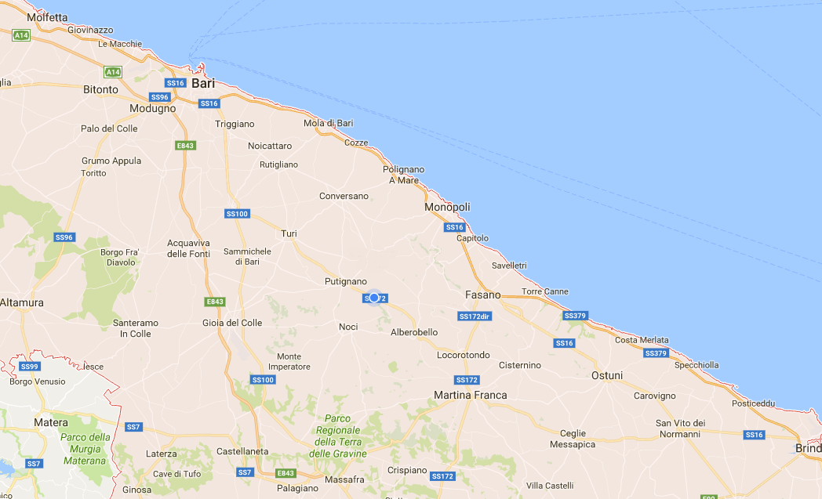
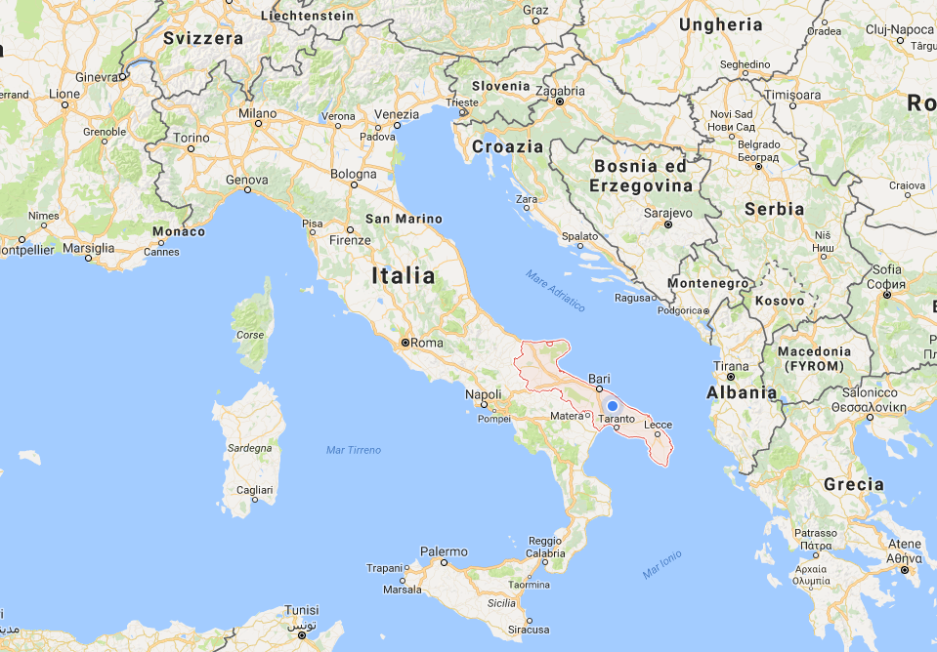
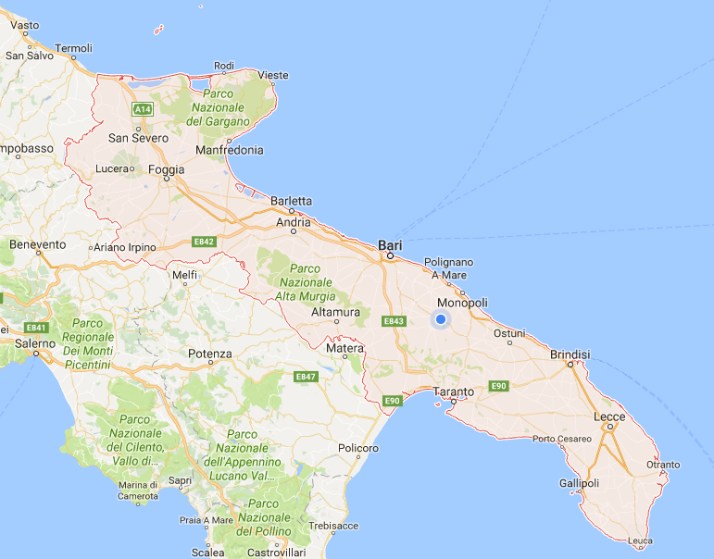
Castellana Grotte

Slide 3
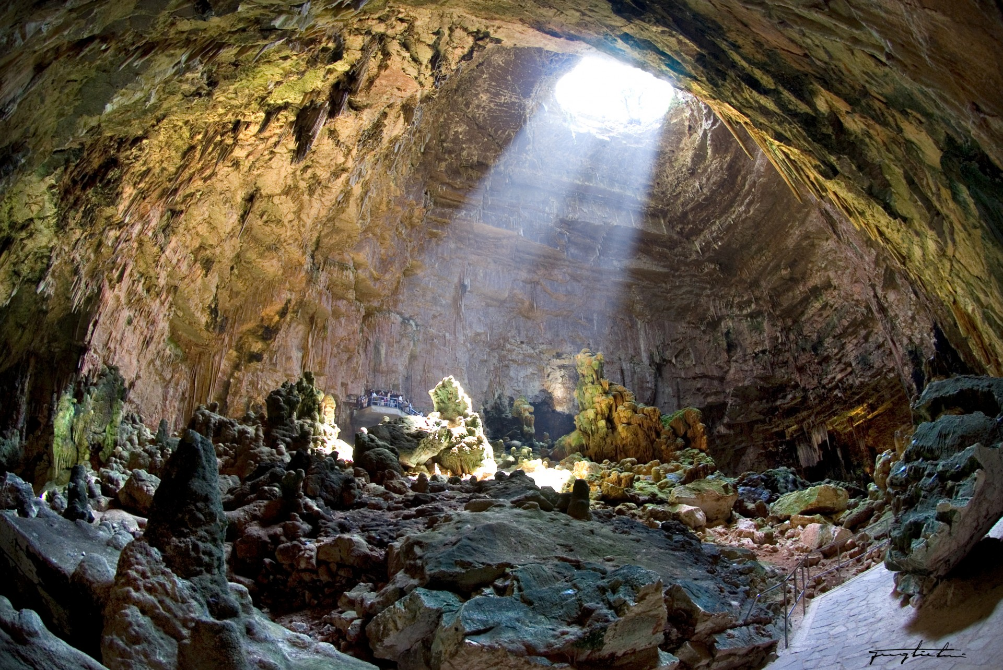
Castellana Grotte

Slide 4
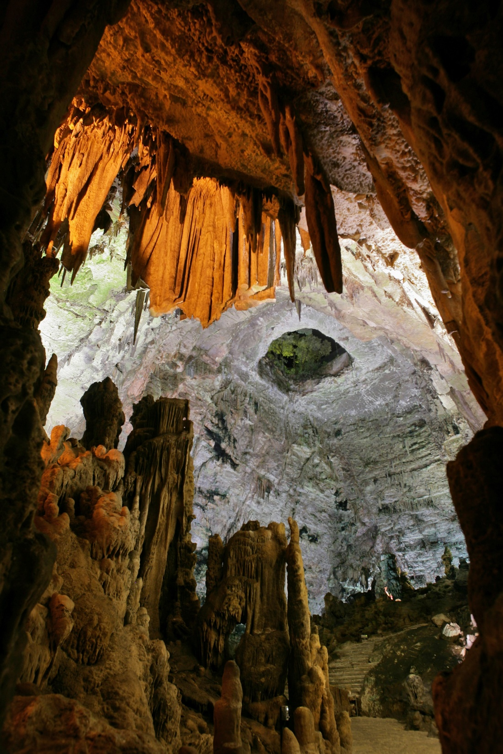
The Caves
The Grotte di Castellana site is one of the most important attractions of Puglia and a natural heritage of inestimable value to Italy.
Located at the entrance of the Itria Valley, a few kilometers from charming villages such as Alberobello, Putignano, Polignano a Mare, the Grotte di Castellana began to form about 90 millions years ago.

Slide 5
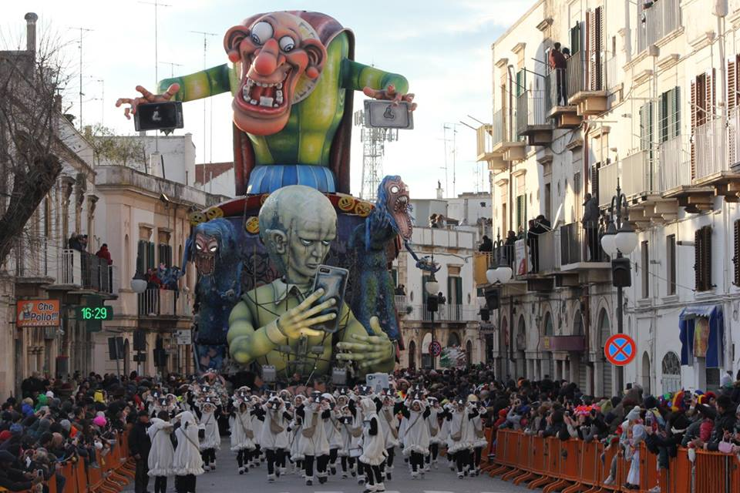
PUTIGNANO

Slide 6
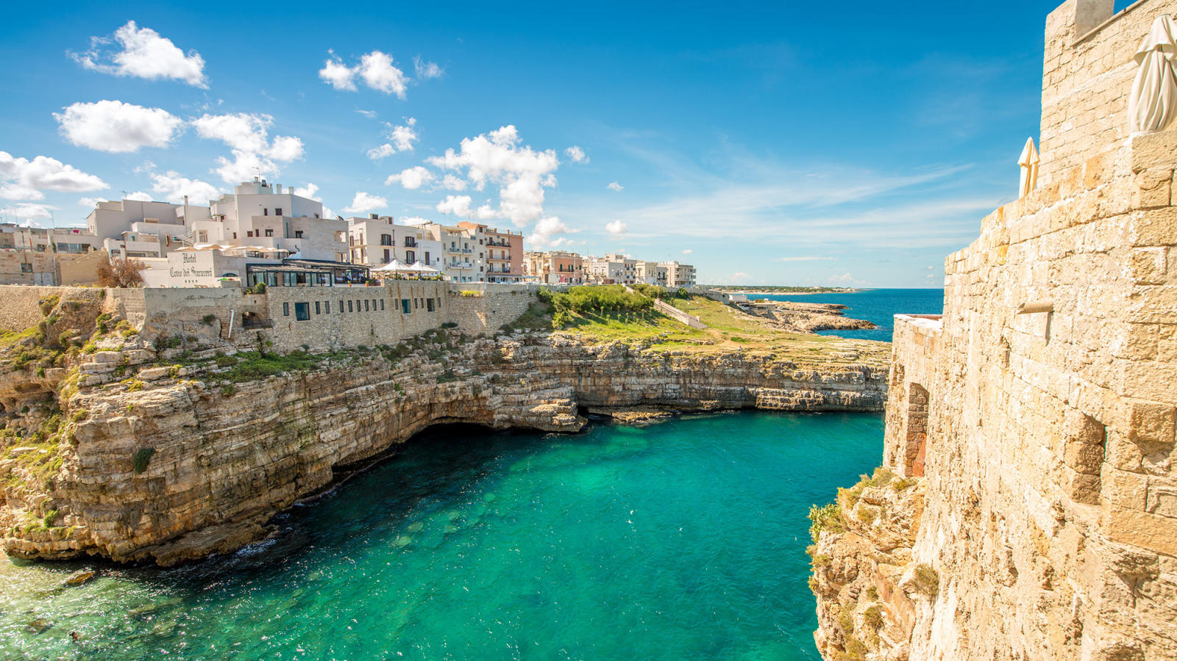
PoPol
POLIGNANO A MARE

Slide 7
ALBEROBELLO

Slide 8
BARI

Slide 9
IT and Telecommunications Degree
«IT and TELECOMMUNICATION»
Courses
Chemistry, Materials and Biotechnology Degree
«CHEMISTRY and MATERIALS»
«ENVIRONMENTAL BIOTECNOLOGY»
BIENNIUM
(Years 1-2)
Single Course
TRIENNIUM
(Years 3-4-5)
Specialization Courses
Agronomy, Agribusiness and Agro-industry Degree
«Production and Processing»
Other School Activities
English Courses for Language Certification
Water Gestures

Slide 10
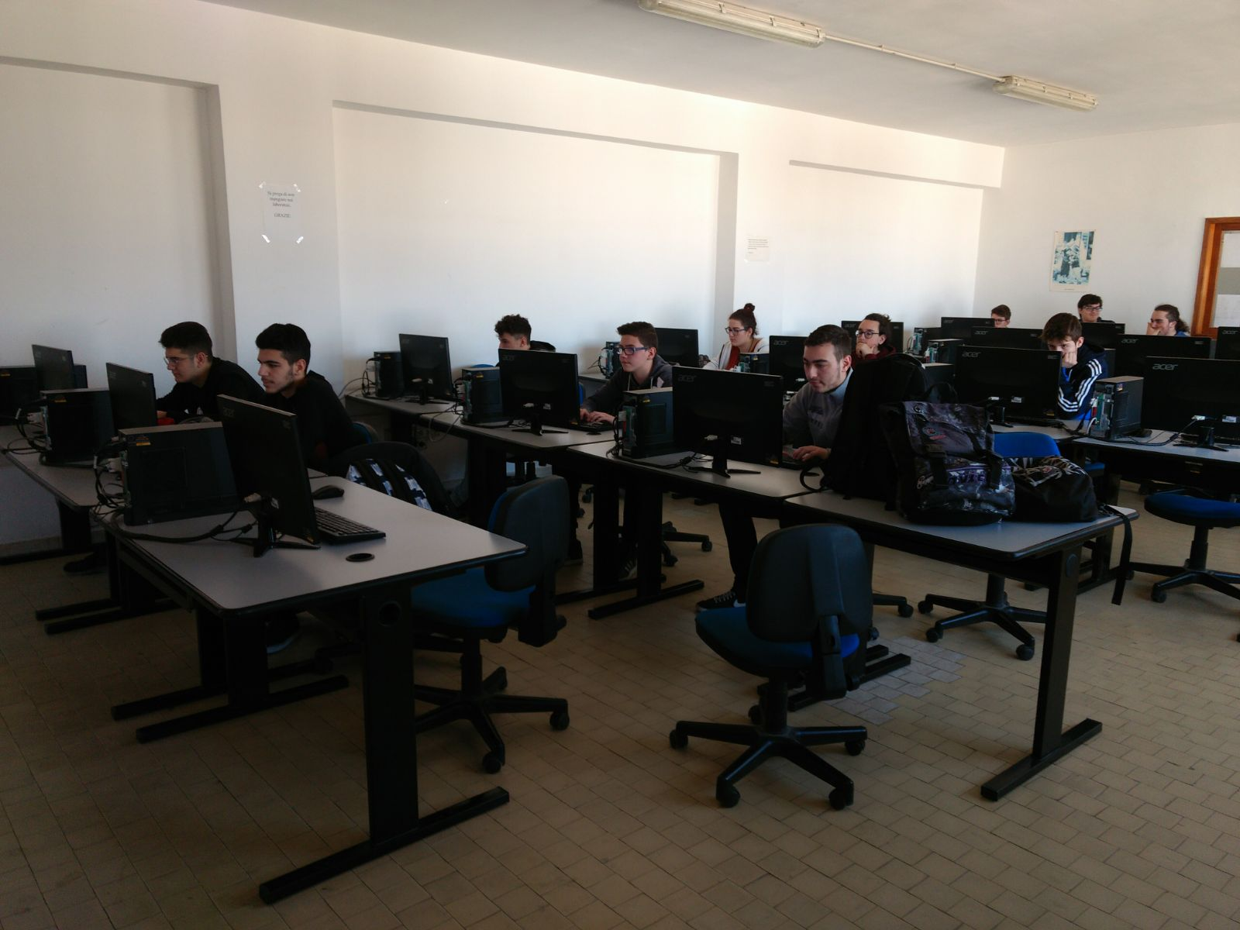
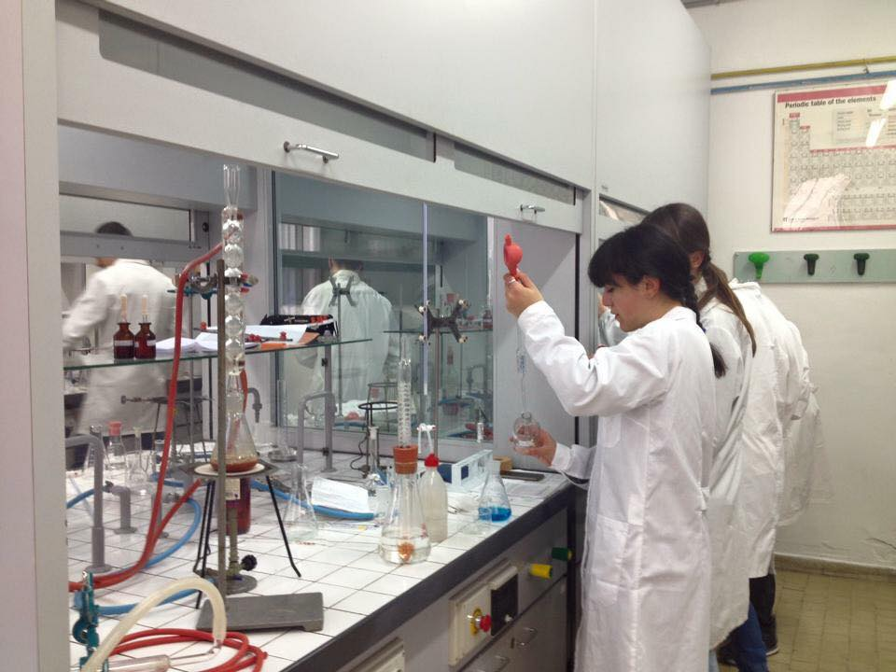
Laboratories
Our school has got thirteen specialized laboratories, including some for I.T., Chemistry and Physics

Slide 11
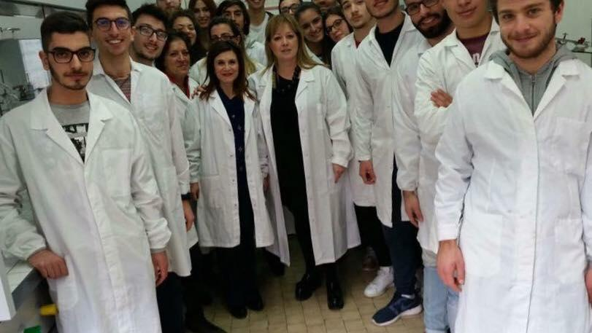
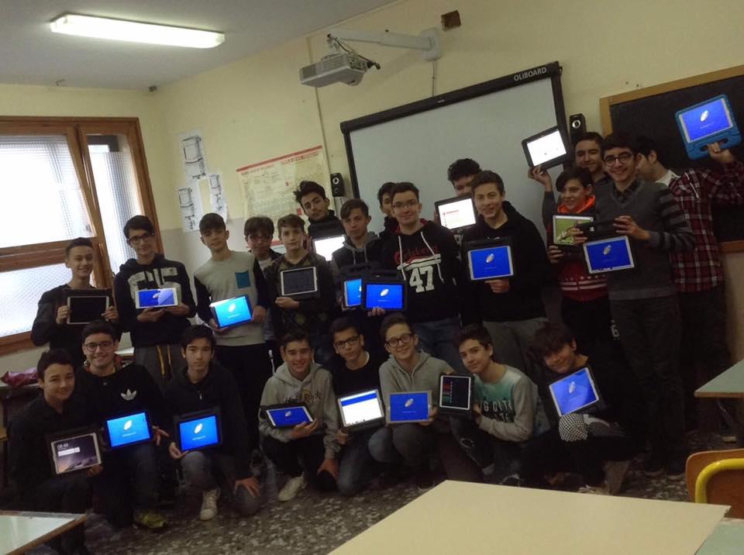
School life

Slide 12
School Timetable
Study courses last 5 years.
Lessons start from Monday to
Saturday for a total of 32 hours a week, which 8
of laboratory.

Slide 13
School organization
Headmistress: Mrs. Teresa Turi
Teachers number: 115
Specialized teachers for disabled students: 6
Specialized Assistants: 2
Students number: 1006
Classes number: 43

Slide 14
The key words of our school
• Scolarships for good students
• Participation in National and International school competitions
• Erasmus +
Students’ assistance
• Support for the students’ needs
Remedial
courses

Slide 15
Main Institute Projects
ECDL (test center)
CISCO (test center)
International exchanges (ERASMUS +)
Summer job placements
Training for Maths, Chemistry and IT competitions
English courses for language Certification
Water Gestures

Slide 16
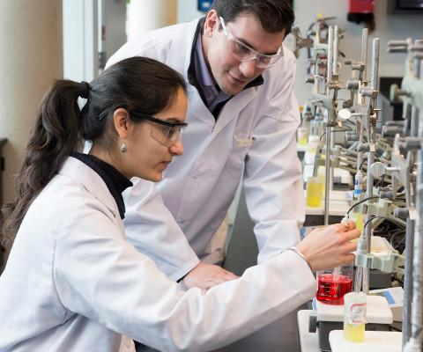
Training in private and public companies

Slide 17
Inclusion…
We talk of Inclusion when, in a group of people, everyone is at the same level.

Slide 18
…it means we’re all equals
Inclusion in school is about leading every student to their highest achievement, whatever conditions they’re in. It also forsees the student being welcomed in the class group and supported to contribute and participate in all aspects of school’s life.
The inclusive ethos permeates all school policies so that they increase learning and participation for all pupils; these ethos and policies are reflected by school practices.
(quoted in Index for Inclusion, CSIE)

Slide 19
The keys for happiness
Factors that make Inclusion a success are:
Attitudes
Skills
Resources
If we focus on these three factors, we’ll surely get positive results.

Slide 20
Inclusive Education in Italy
At school we can find:
Disabled students
Special Educational Needs (SEN) students

Slide 21
Law requirements in Italy
Law 104 of 1992 for students with certificated disabilities;
Law 170 of 2010 for students with specific learning disorders (D.S.A. in Italian)
Notes:
21
Modulo: Legislazione del Lavoro- I contratti collettivi nazionali

Slide 22
Disabled students
We call Disabled student a boy or a girl that has a disease which can be at:
mental level, where they have comprehension disease. In their case, a document called «PEI» is made by a team of doctors/teachers and it forsees a different educational program than the standard one.
motor level, where they present movement limitations but their educational program is the same of their classmates.
Both mental and motor. Also in this case a P.E.I. is the best answer to the student’s needs.
We also need to specify that a person can be identified as «disabled» ONLY by specialists (a team of doctors).

Slide 23
Disabled students: documents to be provided in the Italian school
P.D.F. (Dinamic Personal Profile) – it is the work of a team of doctors (neuropsychiatrist, psychologist, speech terapist), which identifies the nature of the handicap.
P.E.I.,(Individual Education Program) - the document produced by the school, starting from the P.D.F. diagnosis – teachers of every school subjects find the best contents to be studied during the school year and answering to the students’ special needs.

Slide 24
Specific Educational Needs
A student with SEN has, other than school difficulties, social and physical disease that influence negatively his/her life such as:
Difficulties with some or all school work
Difficulties with reading, writing, number of homework or understanding information
Difficulties in expressing themselves or understanding what others are saying
Difficulty in making friends or relating to adults
Difficulty in behaving properly at school or at home
Difficulty in organising their time and space
Some kind of sensory or physical needs which may affect them in school

Slide 25
Specific Learning Disorders
We say that a boy or a girl has Specific Learning Disorders (SLD) when there are difficulties in:
Spelling, understanding and decoding words (Dyslexia)
Handwriting (Dysgraphia) or writing words correctly (Dysortographia)
Learning and doing calculations (Dyscalculia)

Slide 26
S.L.D. students: document to be provided in the Italian school
P.D.P. (Personal didactic program) – subscribed by the school teachers to answer to the S.L.D. students’ special needs in education and studies.

Slide 27
What does inclusion mean?
Inclusion in education is an approach to educating students with
special educational needs. It means that all students attend and are
welcomed in regular classes and are supported to learn, contribute
and participate in all aspects of school’s life. It is a legal, moral and
civil right. But, does it work? More often than not, school is
leaning towards full inclusion in the classrooms.

Slide 28
What does an Italian inclusion classroom
look like?
Usually, two teachers (sometimes a general education teacher and a special education assistant)
Students consist of special education and general education ones, taught together
Notes:
28
Modulo: Legislazione del Lavoro- I contratti collettivi nazionali

Slide 29
Problems Faced By S.L.D. Students
Inferiority complex
Lack of understanding
Isolation and segregation
Lack of expression
Shyness

Slide 30
Benefits Of Inclusive Education
No discrimination with students
Equal educational opportunity to all
School answers to the students’ needs
Equal educational benefits for all students
Families’visions of a typical life for their children can come true
Students’ views are listened to and taken seriously
Individual differences between students are a source of richness and diversity, and not an obstacle

Slide 31
Objectives of an inclusive education
To fulfil the constitutional responsibilities
To enable children to stay with their families
To develop a healthy citizenship
Developing feeling of self respect
Use of modern technology
Social equality
Self - reliant

Slide 32
Barriers In Inclusive Education
Negative approach of teachers and students
Lack of physical facilities
Lack of funds
Lack of trained teachers
Social discrimination
Emotional problems
Educational problems

Slide 33
Role Of Teacher
To interact with family
To be able to solve students’ difficulties
To develop new learning strategies
To be able to develop self confidence
To be able to provide special facilities
To be able to look after their personal needs
To be able to recognize their hidden talents

Slide 34
Strategies To Improve Inclusive Education
Special training for teachers
Special care of special children
Improve new methods of teaching

Slide 35
Thanks for your attention!!!

