Slide 1


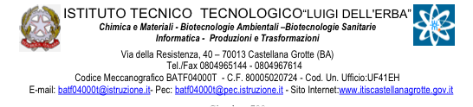
Shared values in the EU: democracy, rule of law, freedom and human rights

Slide 2


European Union
What is it?
Maastricht,
7th February 1992
Political organisation
Economical development

Slide 3
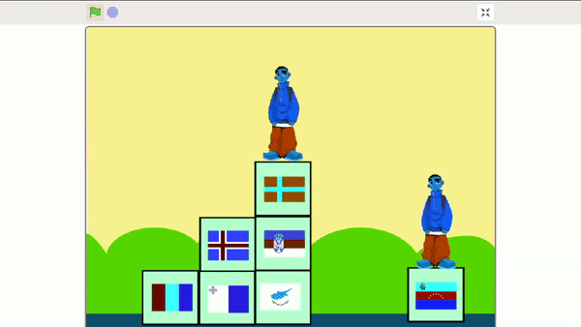
Why being together?
The EU guarantees:
Human rights
Free movement of goods
Free movement of people
Bank and economy union
Long-term peace

Slide 4
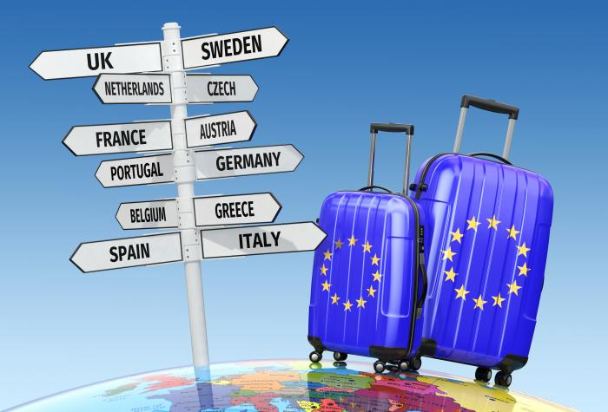
Free movement of people
This is a big advantage for all of the EU citizens.

Slide 5
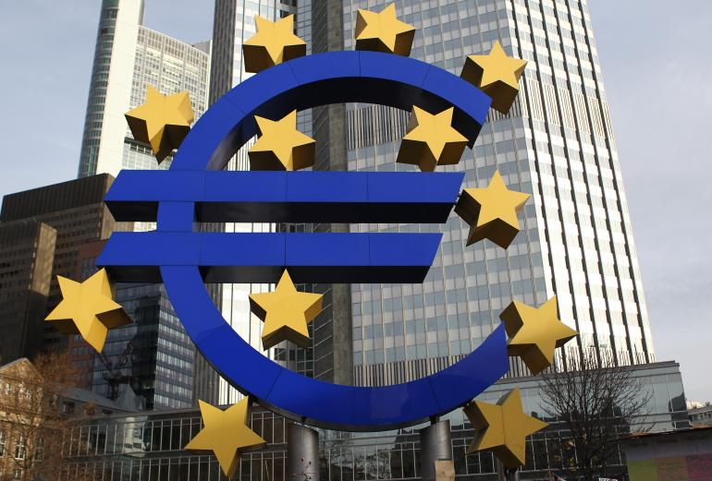
Common market
Being in the EU means for all to access a big common market

Slide 6
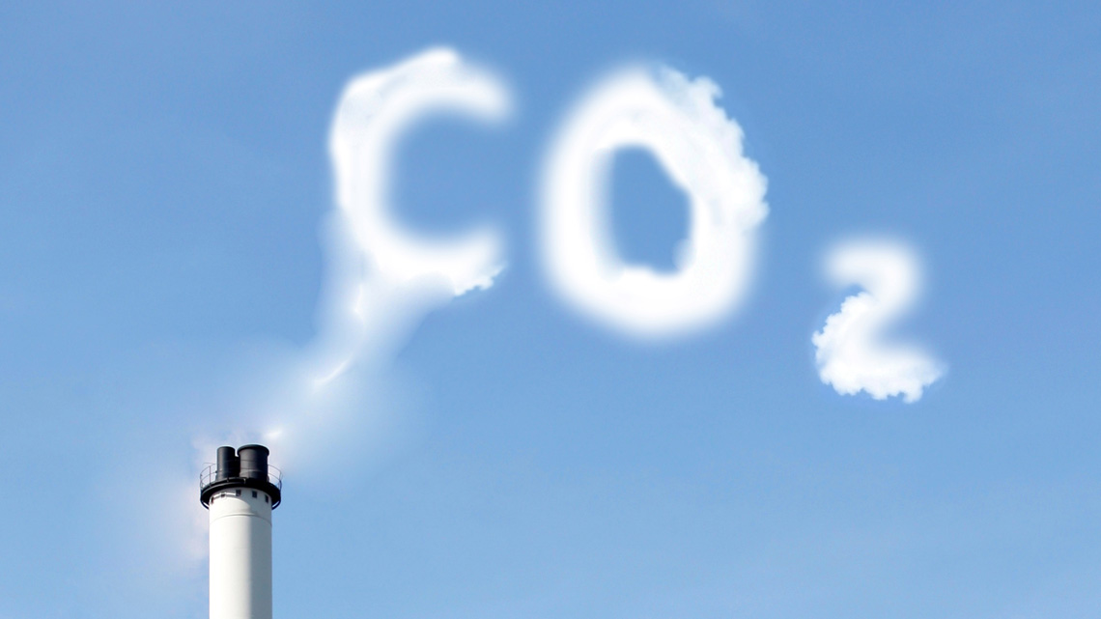

Environment and health
The EU has got laws about environment (like Kyoto Protocol) and about health

Slide 7
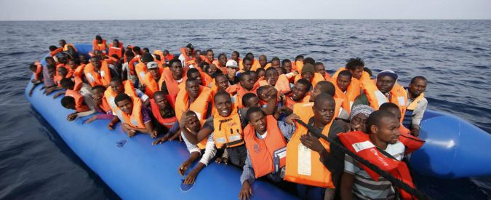
Welcoming
Enshrined in
art. 67 TFUE
art. 18 CDFUE

Slide 8
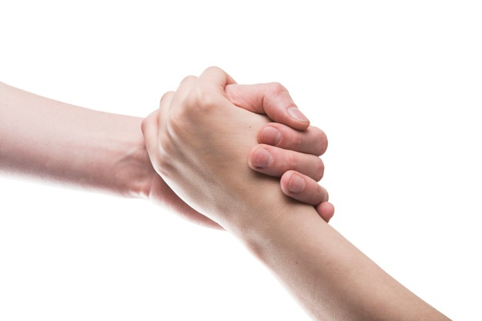

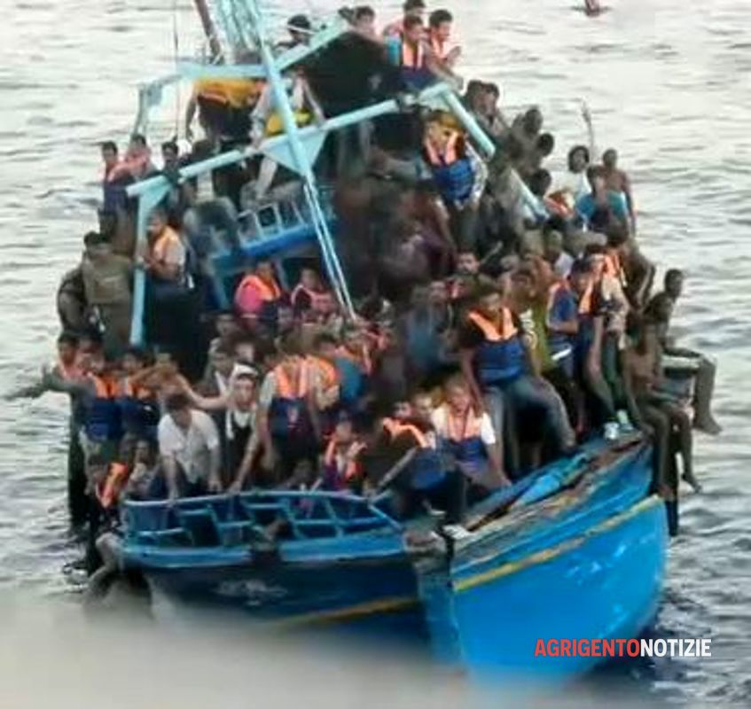
Help us...
...helping others

Slide 9
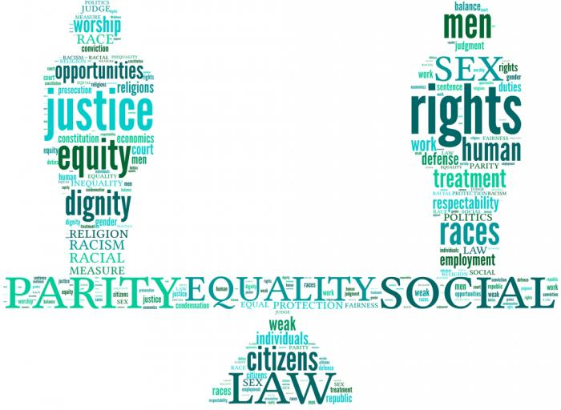
Equality right
European society is based on equality and respect

Slide 10

Education right
The EU promotes education for all the citizens with cultural projects
(ex. Erasmus+)

Slide 11
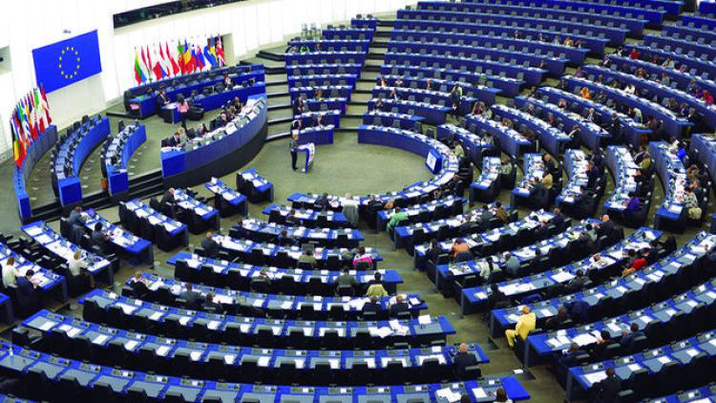

Democracy
The EU has got its own Parliament elected by European citizens every 5 years.
There are 750 members and a President

Slide 12


Bibliography
skuola.net
lenius.it
cittanuova.it
europa.eu
camcomisernia.net
reteclima.it

Slide 13
Created by:
Martina Del Re
Elisa Fanelli
Johnni Gallo
Giacomo Laera
Andrea Mangini
Domenico Sardella

