Slide 1
Erasmus+
Secondary Education Institute - “Luigi dell’Erba” - Castellana Grotte (BA), Italy

Slide 3
Human rights - Law
The European Convention on Human Rights (ECHR) protects the human rights of people in countries that belong to the Council of Europe.
Originally proposed by Winston Churchill and drafted mainly by British lawyers, the Convention was based on the United Nations’ Universal Declaration of Human Rights. It was signed in Rome in 1950 and came into force in 1953.

Slide 4
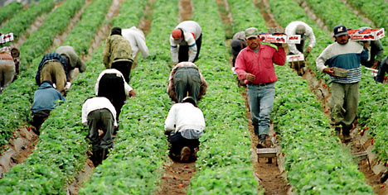
Human rights - violations
One of the social categories that is most affected by human rights violation is migrants’.
Migrants in an irregular situation tend to be more vulnerable to discrimination and exploitation.

Slide 5
Migration - Law
Migrations across the EU are regulated by the 79th and the 80th articles of the Treaty on the Functioning of the European Union (TFEU). These parts ensure that the Union shall develop a common immigration policy and its implementation shall be governed by the principle of solidarity and fair sharing of responsibility.

Slide 6
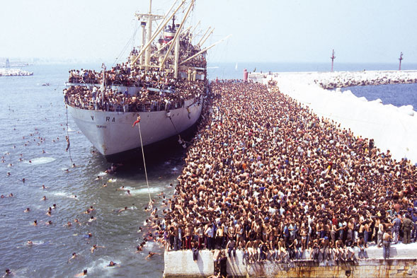
Migration - Spotlight on Italy
Italy, and especially southern Italy, has always been a safe harbour in the Mediterranean.
The picture on the right was taken in 1991 when 20.000 Albanian migrants arrived in Bari, Apulia.
In 2017 Italy had to handle about 115.000 migrants.
Migration started to slow down from 2018 (with 23.000 people) to 2020 where everything almost stopped due to the Coronavirus pandemic.

Slide 7
REALIZED BY:
D’ONGHIA MATTIA
GALLO JOHNNI
MANGINI ANDREA
RECUPERO VALERIO
with the help of the teachers:
prof.ssa maria palazzo
prof.ssa angela sibilia
thank you for your attention!

